Slide 1


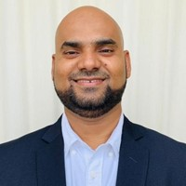




Speaker
Hasnain Shaikh
Zero Trust Approach to Secure Azure Workloads
Hasnain Shaikh
Hasnain__Shaikh
September 16th & 17th
^{Online Event}
Powered By
International Conference

